Slide 1

Java Programming Essentials: A Comprehensive Journey into Core Java and Beyond
Bharath Ashok

Slide 2

Day 3

Slide 3
Day 3: Agenda
Operators in Java
Control Flow Statements
JDK vs JRE vs JVM
OOP(Object Oriented Programming)
Encapsulation
Inheritance
Polymorphism
Abstraction
Class and Objects
Hands-on
Interview Questions
Assignments

Slide 4
Operators in Java
Arithmetic Operators: (+ - * / %)
Assignment Operators: (= += -= *= /= %= &= |= ^= <<= >>= >>>=)
Relational Operators: (== != > < >= <=)
Logical Operators: (&& || !)
Bitwise Operators: (& | ^ ~)
Conditional (Ternary) Operator: ? :
Instanceof Operator: instanceOf

Slide 5
Operators in Java
Arithmetic Operators:
Arithmetic operators perform mathematical calculations on numerical values.
They include addition, subtraction, multiplication, division, and modulus.
Examples:
int sum = num1 + num2
double product = price * quantity;
Assignment Operators:
Assignment operators are used to assign values to variables.
They include the simple assignment operator as well as compound assignments.
Examples:
int count = 0;
total += amount;
instanceof Operator
The instanceof operator checks if an object is an instance of a particular class.
It returns a boolean value indicating the result.
Examples:
boolean isString = obj instanceof String;

Slide 6
Operators in Java
Relational Operators
Relational operators compare two values and return a boolean result.
They include equal to, not equal to, greater than, less than, etc.
Examples:
boolean isEqual: (a == b);
boolean isGreater: (x > y);
Logical Operators
Logical operators combine boolean values and return a boolean result.
They include AND (&&), OR (||), and NOT (!) operators.
Examples:
boolean isValid = (age >= 18) && (hasLicense == true);
boolean canProceed = (isAdmin || isModerator);
Bitwise Operators
Bitwise operators manipulate individual bits of values.
They include AND (&), OR (|), XOR (^), left shift (<<), and right shift (>>).
Display symbols of common bitwise operators with examples.
Examples:
int result = num1 & num2;
int shiftedValue = value << 2;

Slide 7
Operators in Java
Conditional (Ternary)
The ternary operator (? :) provides a concise way to make decisions.
It evaluates a condition and returns one of two values based on the result.
Show the syntax of the ternary operator with an example.
Example:
int max = (a > b) ? a : b;
Bitwise Operators
Bitwise operators manipulate individual bits of values.
They include AND (&), OR (|), XOR (^), left shift (<<), and right shift (>>).
Display symbols of common bitwise operators with examples.
Examples:
int result = num1 & num2;
int shiftedValue = value << 2;

Slide 8
Operators Hands-on

Slide 9
Control Flow Statements

Slide 10
Control Flow Statements
Control flow statements dictate the order in which instructions are executed in a program.
They allow us to make decisions and repeat actions based on conditions.
Role of Control Flow Statements
Decision-Making: Control flow statements help us make choices based on conditions.
Repetition: They enable us to repeat actions or code blocks as needed.
Program Flow: Control flow guides the program's sequence of execution.
Types of Control Flow Statements
if Statement: Executes a block of code if a condition is true.
switch Statement: Provides multi-case branching based on a value.
Loops: Allow repeated execution of code based on conditions.

Slide 11
Control Flow in Code
Using an if and else statement
int age = 20;
if (age >= 18) {
System.out.println("You are an adult.");
} else {
System.out.println("You are a minor.");
}
If, else if, else statement
int score = 85;
if (score >= 90) {
System.out.println("Excellent!");
} else if (score >= 80) {
System.out.println("Good job!");
} else {
System.out.println("Keep it up.");
}

Slide 12
Loops
for loop
while loop
do while loop

Slide 13
Break and Continue Statements
The break and continue statements are control flow statements in java
They offer more precise control over loops and switch statements
Break Statement:
Terminates the nearest enclosing loop or switch statement.
Useful for early loop termination or exiting switch cases.
for (int i = 1; i <= 5; i++) {
if (i == 3) {
break; // Exit the loop when i is 3
}
System.out.println("Iteration: " + i);
}
Continue Statement:
Skips the remaining code in the current iteration.
Proceeds to the next iteration of a loop.
for (int j = 1; j <= 5; j++) {
if (j == 3) {
continue; // Skip iteration when j is 3
}
System.out.println("Iteration: " + j);
}

Slide 14
Nested Loops
Nested loops involve placing one loop inside another.
Role of Nested Loops:
Multi-Dimensional Data: Nested loops handle multi-dimensional arrays or structures.
Grids and Matrices: Useful for traversing rows and columns.
Complex Algorithms: Enable solving intricate problems requiring intricate iteration.
Example:
for (int i = 1; i <= 10; i++) {
for (int j = 1; j <= 10; j++) {
int result = i * j;
System.out.print(result + "\t");
}
System.out.println();
}

Slide 15
Control-flow Statements Hands-on

Slide 16
Interview Questions

Slide 17
Control Flow Statements
What is the purpose of the if-else statement in Java?
How is a switch statement different from an if-else statement?
Explain the role of the "break" statement in a switch case.
What is the purpose of a loop in programming?
Provide examples of different types of loops in Java.
How can you prevent an infinite loop from running indefinitely?

Slide 18
JVM vs JRE vs JDK

Slide 19
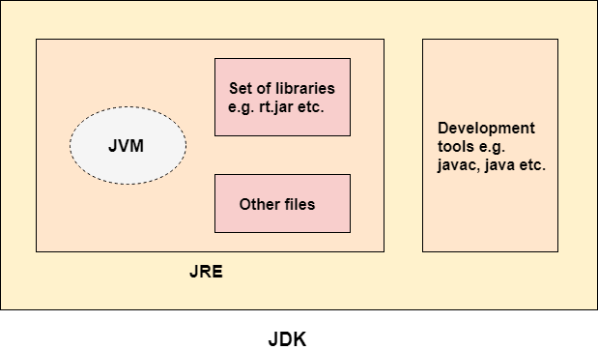
JDK vs JRE vs JVM

Slide 20
OOP(Object Oriented Programming)

Slide 21
Introduction to Object-Oriented Programming (OOP)
Definition of OOP
Advantages of OOP
Overview of OOP principles (Encapsulation, Inheritance, Polymorphism, Abstraction)

Slide 22
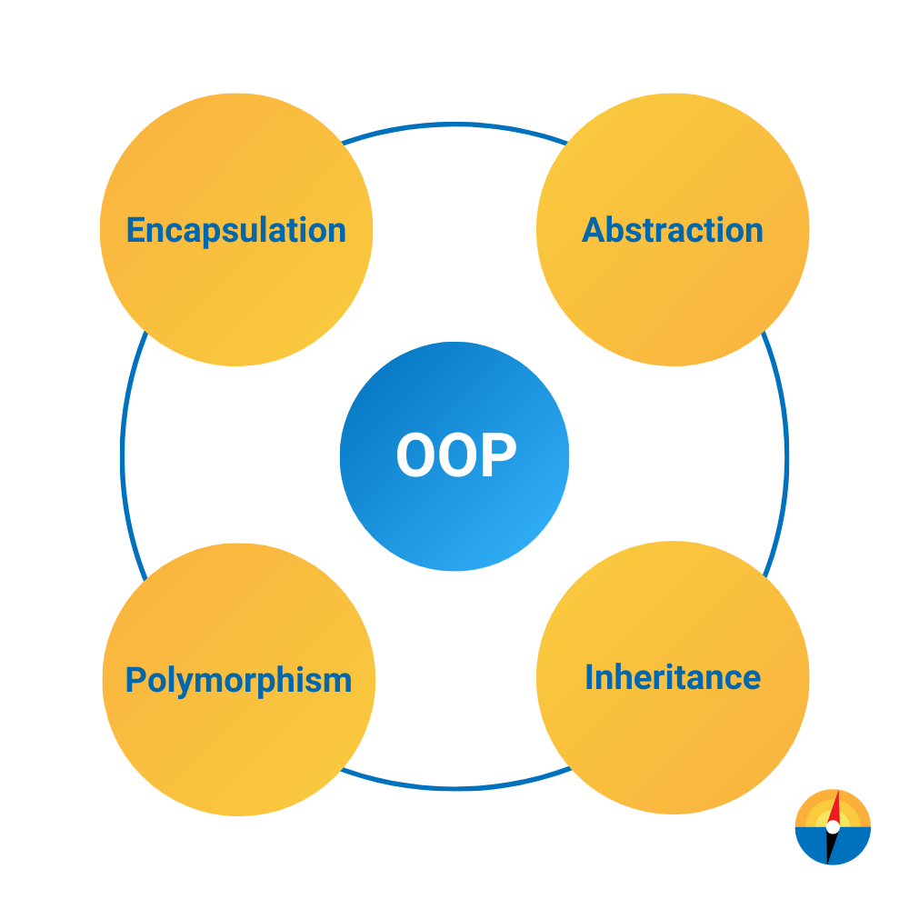
Object-Oriented Programming (OOP)
OOP is a programming paradigm that uses objects and classes to design and structure software.
OOP focuses on modeling real-world entities as objects, and these objects can have attributes (data) and behaviors (methods).
Programs in Java are constructed using classes, objects, and their interactions.
OOP in Java emphasizes modularity, reusability, and maintainability.
Key OOP concepts in Java include encapsulation, inheritance, polymorphism, and abstraction.

Slide 23
Advantages of Object-Oriented Programming
OOP offers numerous benefits that contribute to better software development.
Modularity and Reusability: Code is organized into reusable objects.
Maintainability: Changes to one object do not affect others.
Flexibility: Objects can be easily extended or modified.
Abstraction and Simplicity: Focus on essential aspects of objects.
Efficiency: Promotes efficient resource utilization.
Scalability: New objects can be added without altering existing ones.

Slide 24
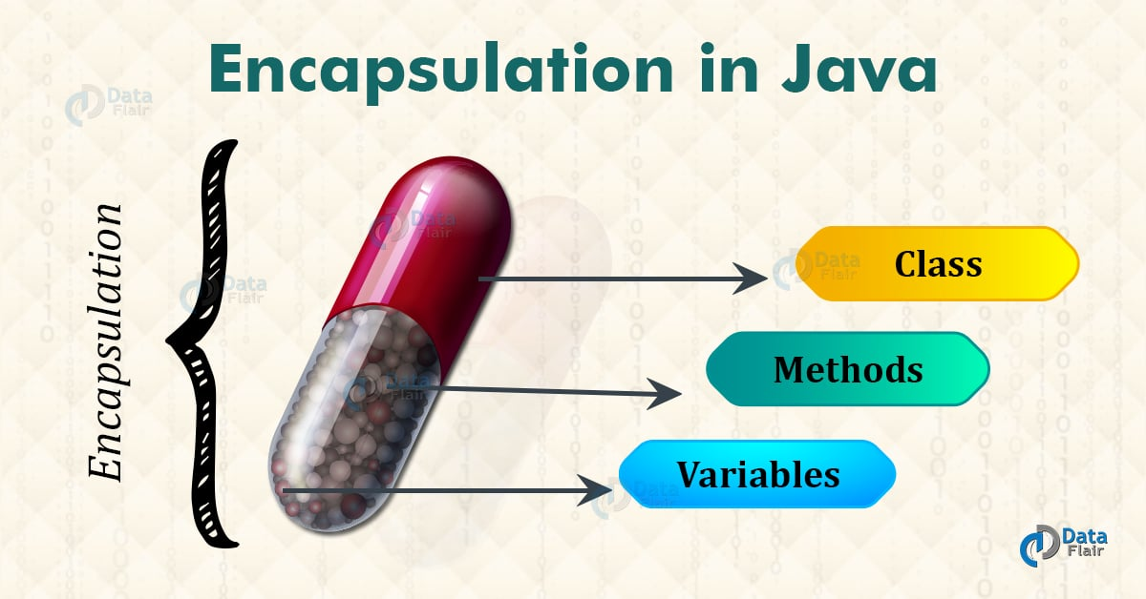
Encapsulation
Encapsulation is a fundamental concept in Object-Oriented Programming (OOP).
It involves bundling data (attributes) and methods (functions) that operate on the data within a single unit, known as a class.
Key Aspects of Encapsulation:
Data Protection: Attributes are often marked as private, limiting direct access from outside the class.
Controlled Access: Methods act as gatekeepers, regulating how data is accessed and modified.
Information Hiding: Internal details are hidden, exposing only necessary methods for interaction.
Code Flexibility: Encapsulation allows for easy changes to the internal implementation without affecting external code

Slide 25
Encapsulation Examples

Slide 26
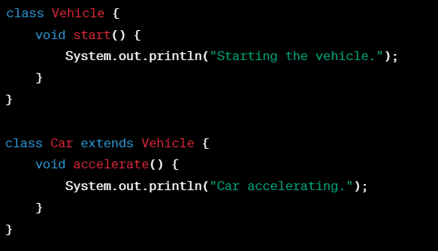
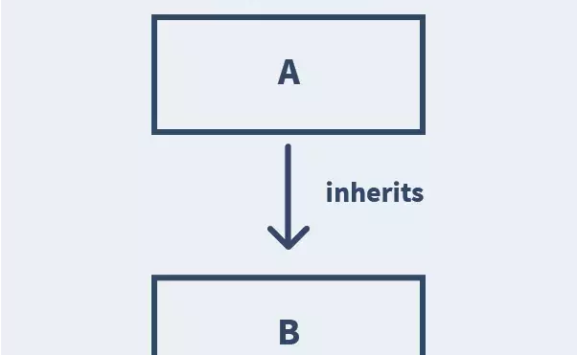
Inheritance
Inheritance is a core concept in Object-Oriented Programming (OOP).
It allows a new class (subclass or derived class) to inherit properties and behaviors from an existing class (superclass or base class).
Key Aspects of Inheritance:
Code Reusability: Inheritance promotes reuse of existing code, enhancing modularity.
Hierarchy: Classes can be organized in a hierarchical structure.
"Is-A" Relationship: Subclasses are specialized versions of their superclasses.
Overriding: Subclasses can override (modify) inherited methods to provide specific behavior.
Access to Members: Subclasses may access public and protected members of their superclass.

Slide 27
Inheritance Examples

Slide 28
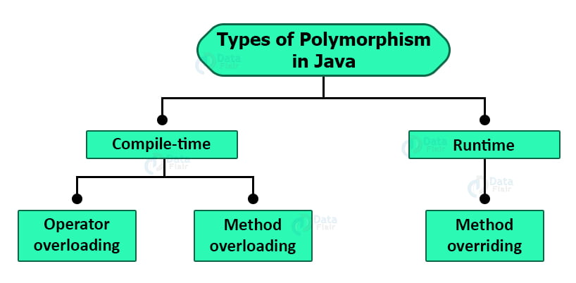
Polymorphism
Polymorphism allows objects of different classes to be treated as objects of a common superclass, enabling a single method to have multiple implementations based on the type of object it is called on.
Polymorphism is achieved through method overriding and method overloading.
Compile-Time Polymorphism (Method Overloading):
Compile-time polymorphism occurs when multiple methods in the same class have the same name but different parameters (method signature).
The appropriate method to call is determined by the arguments passed during the method invocation.
Method overloading allows you to provide different implementations for different scenarios.
Runtime Polymorphism (Method Overriding):
Runtime polymorphism occurs when a subclass provides a specific implementation for a method that is already defined in its superclass.
he method in the subclass must have the same name, return type, and parameters as the method in the superclass.
The actual method to be executed is determined at runtime based on the actual type of the object, not the reference type.

Slide 29
Polymorphism Examples

Slide 30
Abstraction
Abstraction is a fundamental concept in Object-Oriented Programming (OOP) .
Abstraction allows you to hide the implementation details of an object and provide a simplified and generalized view
In Java, abstraction is achieved using abstract classes and interfaces.
Key Aspects of Abstraction:
Hiding Complexity: Abstraction hides the internal implementation details of an object, exposing only what is necessary for interaction.
Creating Abstract Classes and Interfaces: In Java, you can create abstract classes and interfaces that define the structure and behavior without providing full implementations.
Abstract Methods: Abstract classes and interfaces can include abstract methods, which are method declarations without implementations. Subclasses or implementing classes must provide concrete implementations for these methods.

Slide 31
Abstraction Examples

Slide 32
Java Objects
Instantiating Objects
Creating an instance of a class (object)
Class definition and syntax in Java
Accessing object properties and invoking methods
Object references and the heap memory

Slide 33
Class
In Java, a class is a blueprint or template for creating objects.
It defines the structure and behavior that objects of that class will have.
A class encapsulates data (attributes) and behavior (methods) that describe a certain type of object. In other words, a class provides the blueprint for creating instances (objects) that share common characteristics and behaviors.
Key Aspects of a Class:
Attributes (Fields): Attributes are variables declared within a class, representing the data or state of objects created from that class.
Methods (Functions): Methods are functions defined within a class, representing the behavior or actions that objects can perform.
Constructor: A constructor is a special method that initializes an object when it is created. It typically sets initial values for the object's attributes.
Access Modifiers: Access modifiers (e.g., public, private, protected) control the visibility of class members (attributes and methods) to other parts of the program.
Instance of a Class: An object is an instance of a class, created using the new keyword. Each object has its own set of attributes and can call the methods defined in the class.

Slide 34
Class Example:
class Person {
// Attributes
String name;
int age;
// Constructor
public Person(String name, int age) {
this.name = name;
this.age = age;
}
// Method
public void introduce() {
System.out.println("Hi, I am " + name + " and I am " + age + " years old.");
}
}

Slide 35
Objects
An object represents a real-world entity, combining data (attributes) and behavior (methods) that define its characteristics and actions.
Key Aspects of an Object:
Attributes (Fields): Attributes are variables that hold data, representing the state of an object. They define the properties or characteristics of the object.
Methods (Functions): Methods are functions associated with an object. They define the actions or behaviors that the object can perform.
Instance of a Class: An object is an instance of a class. The class acts as a blueprint or template that defines the structure and behavior of the object.
State and Behavior: An object's state is determined by the values of its attributes, and its behavior is determined by the methods it can execute.

Slide 36
Object Example:
class Person {
String name;
int age;
void introduce() {
System.out.println("Hi, I am " + name + " and I am " + age + " years old.");
}
}
public class Main {
public static void main(String[] args) {
// Creating objects
Person person1 = new Person();
Person person2 = new Person();
// Setting attributes
person1.name = "Alice";
person1.age = 25;
person2.name = "Bob";
person2.age = 30;
// Calling methods
person1.introduce(); // Output: Hi, I am Alice and I am 25 years old.
person2.introduce(); // Output: Hi, I am Bob and I am 30 years old.
}
}

Slide 37
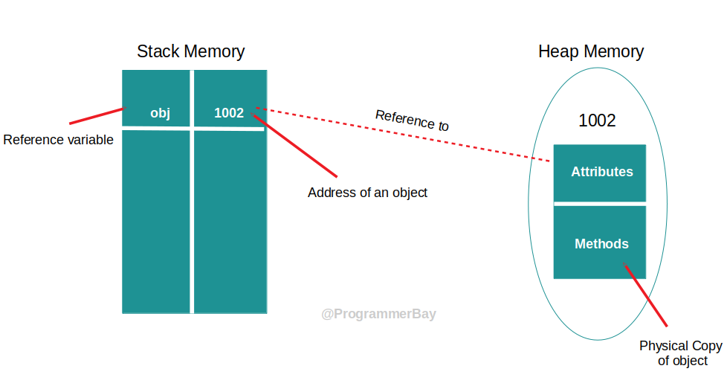
Object References and Heap Memory
Object Reference
An object reference is a variable that holds the memory address of an object.
It acts as a pointer to the actual object's location in the heap.
Heap Memory
The heap is a region of memory where objects are allocated and managed.
Objects created using the new keyword are dynamically allocated in the heap

Slide 38
Class Members
Variables and Methods
Instance variables (data members)
Methods and their role in encapsulation

Slide 39
Class Members Examples

Slide 40
Constructors
Constructors
Purpose of constructors
Default constructor vs. parameterized constructor

Slide 41
Constructors
Constructors are special methods used to initialize objects when they are created.
They provide a way to set initial values for object attributes.
Purpose of Constructors
Constructors ensure that objects are properly initialized and in a consistent state.
They allow you to provide initial values for attributes when creating objects.
class Person {
String name;
// Constructor
public Person(String n) {
name = n;
}
}

Slide 42
Default Constructor
If a class does not explicitly define any constructors, a default constructor is provided automatically.
The default constructor has no parameters and performs basic initialization.
Purpose of Default Constructors
Default constructors ensure that objects are created with valid initial values, even if not explicitly defined.
They serve as a fallback mechanism for object initialization.
class Book {
// Default constructor
public Book() {
// Perform default initialization
}
}

Slide 43
Parameterized Constructors
Parameterized constructors are a type of constructor that accept parameters to initialize object attributes.
They provide a way to customize object creation by passing values during instantiation.
Purpose of Parameterized Constructors
Parameterized constructors allow you to initialize object attributes with specific values.
They enable customization and provide flexibility during object creation.
class Student {
String name;
int age;
// Parameterized constructor
public Student(String n, int a) {
name = n;
age = a;
}
}

Slide 44
Constructors Examples

Slide 45
Interfaces
Defining an interface in Java
Implementing Interfaces
Syntax for implementing interfaces
Multiple interface implementation

Slide 46
Interfaces
An interface in Java is a blueprint of a class that defines a set of method signatures (without implementations) that must be implemented by any concrete class that implements the interface.
It provides a way to achieve abstraction and multiple inheritance, allowing classes to share common behavior without enforcing a specific hierarchy.
Purpose of Interfaces
Interfaces define a set of methods that a class must implement.
They provide a way to achieve multiple inheritance and ensure code reusability.
Defining an Interface in Java
An interface is defined using the interface keyword followed by its name.
interface Shape {
double calculateArea();
double calculatePerimeter();
}

Slide 47
Implementing Interfaces
To use an interface, a class must implement it by providing concrete implementations for its methods.
A class can implement multiple interfaces, inheriting behavior from each.
class Circle implements Shape {
double radius;
Circle(double r) {
radius = r;
}
@Override
public double calculateArea() {
return Math.PI * radius * radius;
}
@Override
public double calculatePerimeter() {
return 2 * Math.PI * radius;
}
}

Slide 48
Benefits of Interfaces
Multiple Inheritance: Classes can implement multiple interfaces.
Code Reusability: Common behavior can be defined in interfaces.
Loose Coupling: Classes can be decoupled from implementation details.
Contractual Agreement: Ensures that implementing classes adhere to a defined contract.

Slide 49
Multiple interface implementation
Multiple interface implementation in Java refers to the ability of a class to implement more than one interface. This allows a single class to inherit and provide implementations for methods defined in multiple interfaces. This concept enables a form of multiple inheritance in Java, where a class can inherit behavior from multiple sources.
Here's how multiple interface implementation works:
Interface Definition: Define two or more interfaces, each specifying a set of method signatures that classes implementing them must provide.
Class Implementation: Create a class that implements multiple interfaces. The class must provide concrete implementations for all the methods defined in each interface it implements.
Method Implementations: Write the method implementations for each interface's methods in the implementing class.

Slide 50
Interfaces Examples

Slide 51
Abstract Classes
What are abstract classes?
Creating abstract classes in Java
Differences between interfaces and abstract classes

Slide 52
Abstract classes
An abstract class is a class that cannot be instantiated on its own and can have both abstract and concrete (non-abstract) methods
They serve as blueprints for other classes to extend from and provide a foundation for creating related classes with shared behavior.
Defining an Abstract Class
An abstract class is defined using the abstract keyword.
It can include abstract methods and concrete methods.
abstract class Shape {
abstract double calculateArea();
void printInfo() {
System.out.println("This is a shape.");
}
}

Slide 53
Abstract classes Examples

Slide 54
Interfaces vs Abstract Classes
Feature | Interfaces | Abstract Classes
Definition | Interface is a collection of abstract methods and constants | Abstract class is a class with abstract and concrete methods
Inheritance | Supports multiple inheritance through interface | Supports single inheritance, but can be used with interfaces
Constructor | Cannot have constructors | Can have constructors, used for initialization
Fields | Only constant fields (implicitly public, static, final) | Can have instance variables with various access modifiers
Method Access Modifiers | Implicitly public and abstract | Can have a range of access modifiers (public, private, etc.)
Method Implementation | Methods have no default implementation | Abstract methods have no implementation, concrete methods do
Keyword | Defined using 'interface' keyword | Defined using 'abstract' keyword
Purpose | Used for defining contracts and multiple inheritance | Used for code reusability and providing a common structure
Relationship to Classes | Separate from classes, implemented by classes | Inherited by subclasses, extended to create concrete classes
Usability with Java Versions | Available from Java 1.0 onwards | Available from Java 1.0 onwards

Slide 55
Interview Questions

Slide 56
OOP Interview Questions
What is OOP, and what are the core principles of OOP?
Explain the concepts of encapsulation, inheritance, and polymorphism in OOP.
What is an object in Java? How is it different from a class?
What is the difference between abstraction and interface in Java?
What is the purpose of using access modifiers (public, private, protected, default) in Java?
How do you achieve multiple inheritance in Java? Can you provide an example?
What is method overloading and method overriding? How are they different?
What are abstract classes in Java? When and why should you use them?
What are interfaces in Java, and how do they differ from abstract classes?
Can you explain the concept of constructors and their significance in Java?
What is the difference between an instance variable and a static variable in Java?
How do you prevent a class from being inherited by other classes in Java?
How can you achieve runtime polymorphism in Java?

Slide 57
OOP Interview Questions
What is the 'super' keyword in Java, and when do you use it?
What is the purpose of the 'this' keyword in Java?
How does Java support encapsulation? Provide an example.
How do you call a superclass constructor using the super keyword? Provide an example.
When is the use of super() constructor call mandatory in a subclass constructor?
Can you use the super keyword to access superclass methods? Explain with an example.
What happens if you don't explicitly call the super() constructor in a subclass constructor?
How does the super keyword relate to method overriding in Java?
How does the this keyword differ from the super keyword?
Can you use the this keyword inside a static method? Why or why not?

Slide 58

Assignments

Slide 59
Library Management System
Create a Java program for a basic Library Management System using OOP principles. The system should have the following classes:
Book: This class represents a book with attributes like title, author, and publication year. It should have methods to display book details.
Student: This class represents a student with attributes like name, roll number, and a list of borrowed books. It should have methods to borrow and return books.
Library: This class manages the books in the library and the students who borrow them. It should have methods to add books to the library, display available books, allow students to borrow and return books, and display a student's borrowed books.
Requirements:
Create the Book class with appropriate attributes and methods.
Create the Student class with attributes and methods for borrowing and returning books.
Create the Library class that maintains a list of books and students.
Demonstrate inheritance by creating a ReferenceBook class that inherits from Book and has additional attributes like ISBN and reference section.
Implement a basic user interface in the Main class to interact with the library system. Allow users to add books, add students, borrow and return books, and display information.

Slide 60
Sample Code Structure
class Book {
// Attributes: title, author, publicationYear
// Methods: displayDetails()
}
class Student {
// Attributes: name, rollNumber, borrowedBooks (List<Book>)
// Methods: borrowBook(Book), returnBook(Book),
// displayBorrowedBooks()
}
class Library {
// Attributes: books (List<Book>), students (List<Student>)
// Methods: addBook(Book), displayAvailableBooks(),
// borrowBook(Student, Book), returnBook(Student, Book),
// displayStudentBorrowedBooks(Student)
}
class ReferenceBook extends Book {
// Additional attribute: isbn, referenceSection
}
public class Main {
public static void main(String[] args) {
// Create instances of Library, Book, Student, and ReferenceBook classes
// Implement a user interface to interact with the library system
}
}

Slide 61
Creating a Simple Bank Account System
Create a Java program for a simple bank account system using OOP principles. The system should have the following classes:
BankAccount: This class represents a bank account with attributes like account number, account holder's name, and balance. It should have methods to deposit, withdraw, and display the balance.
Main: This class contains the main method to interact with the bank account system. It should allow users to create accounts, perform deposits, withdrawals, and display account details.
Requirements:
Create the BankAccount class with attributes and methods for depositing, withdrawing, and displaying balance.
Create the Main class with a user interface to interact with the bank account system.

Slide 62
Sample Code Structure
class BankAccount {
// Attributes: accountNumber, accountHolderName, balance
// Methods: deposit(double), withdraw(double), displayBalance()
}
public class Main {
public static void main(String[] args) {
// Create instances of BankAccount class
// Implement a user interface to allow users to create accounts, deposit, withdraw, and display account details
}
}

Slide 63

Q&A

